Slide 1

DETECTING EMAIL-BASED PHISHING WEBSITES USING MACHINE LEARNING
TMP-23-123

Slide 2



Team Members
J.M.Lindamulage
Mandira Pabasari L.
Yapa S.P.J.
Perera I.S.S.

Slide 3

Content
Introduction
Research question
Objectives
Overall system diagram
Individual Components section
Gantt Chart
Commercialization
Budget

Slide 4

Introduction
Email phishing
A combination of social engineering
Attackers send spoof emails impersonating as trustworthy parties.
The recipient is then tricked into clicking a malicious link, which can lead to the installation of malware or the revealing of sensitive information.
These malicious links will redirect the victims to phishing sites that looks legitimate to the original.
If victim login to their accounts or give sensitive information attackers can get them.

Slide 5
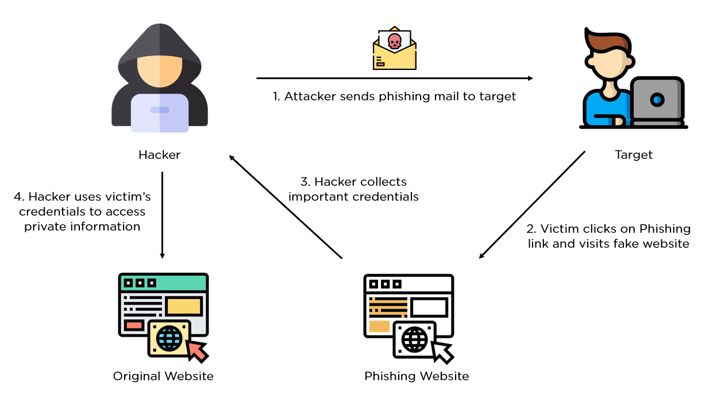
Introduction

Slide 6

Research questions
How to use visual similarity to detect phishing websites?
How to use the network behavior to detect phishing websites?
How to identify phishing email by the header and the text in the mail?
How to detect phishing websites focusing on the URL of the suspicious website?
How to inform a user about a phishing email or a phishing website through a browser extension and a mobile app?

Slide 7
Objectives
To implement a mobile application and a web extension capable of detecting phishing emails and web sites utilizing machine learning models.
Main objective

Slide 8
Sub-objectives
To employ the visual similarity features to classify phishing websites out of legit websites.
To explore how to employ network behavior to classify phishing websites.
To identify phishing emails using the heading and the textual content in the email.
To discover phishing websites using the URL.

Slide 9
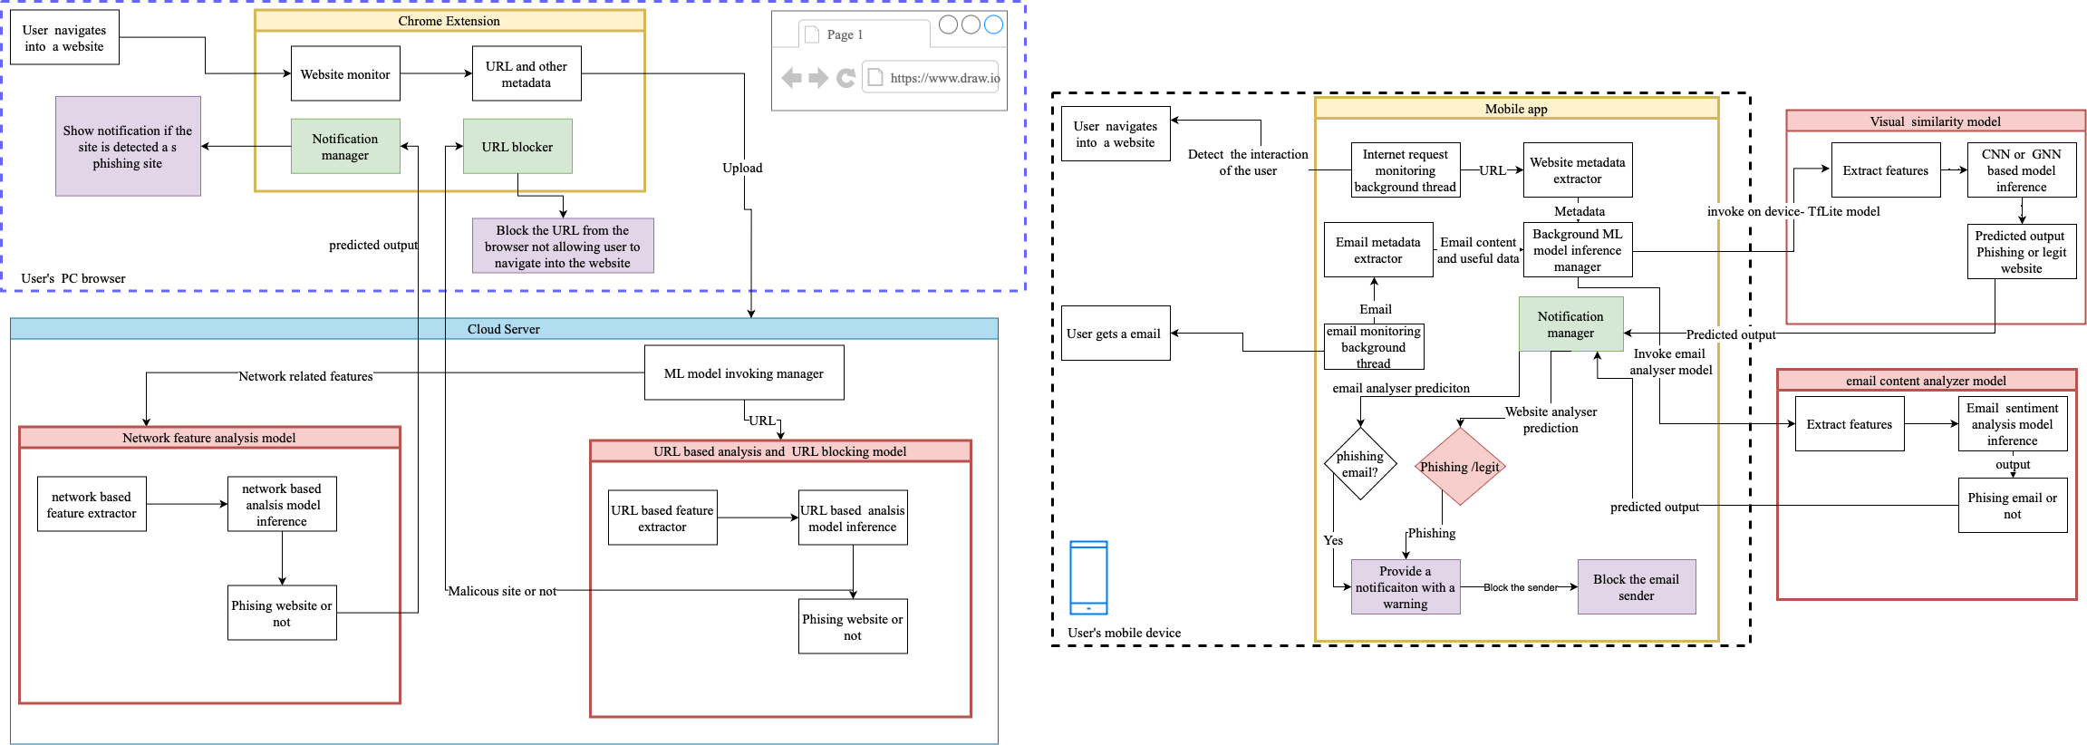
Overall system diagram

Slide 10

Individual components

Slide 11
IT20222840 |J.M.Lindamulage
BSc (Hons) Degree in Information Technology (specialization in Cyber Security )
IT20222840 | J.M.Lindamulage| TMP-23-123

Slide 12
Introduction
Background
Over the few years , there is a rise of phishing attacks with the covid 19 pandemic.
In a survey [7] conducted on identifying phishing sites, 90% of the respondents were unable to identify a phishing website from a legitimate one.
There is a high visual resemblance between the phishing website and the targeted legitimate site, such as page layouts, images, text content, font size, and font color [6].
IT20222840 | J.M.Lindamulage| TMP-23-123

Slide 13
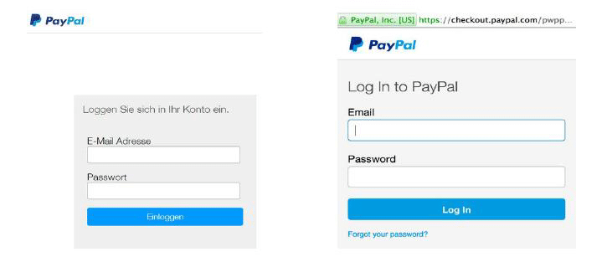
Phishing websites
Fake PayPal login page (left) and original PayPal login page (right).
Fake
Legit
IT20222840 | J.M.Lindamulage| TMP-23-123

Slide 14

Research Gap
IT20222840 | J.M.Lindamulage| TMP-23-123

Slide 15


Reference | Use CNN | Use GNN | Text | Embedded Images | Overall appearance/color | Utilized Source code | Logo | Mobile application
[12]
[13] DeltaPhish
VisualPhishNet[14]
[15]
[16]
[17]
Proposed system
IT20222840 | J.M.Lindamulage| TMP-23-123

Slide 16
Research Problems
How to enhance an existing dataset with more updated features focusing on visual similarity features which can be utilized to classify phishing websites.
How to build a generalized model that can detect phishing websites which do not contain in the dataset.
How to further optimize the size and the inference time of the model, to be able to deploy the models on the mobile app itself.
IT20222840 | J.M.Lindamulage| TMP-23-123

Slide 17
Objectives
Specific objective
Identify phishing websites using visual similarity.
IT20222840 | J.M.Lindamulage| TMP-23-123

Slide 18
Sub objectives
To develop a machine learning model that can detect phishing websites using visual similarity of a websites.
To improve model to be able to detect new phishing websites that are not in the data set that was used for training purposes.
To further optimize the size and the inference time of the model for edge computing.
To integrate the developed models to a mobile application.
IT20222840 | J.M.Lindamulage| TMP-23-123

Slide 19
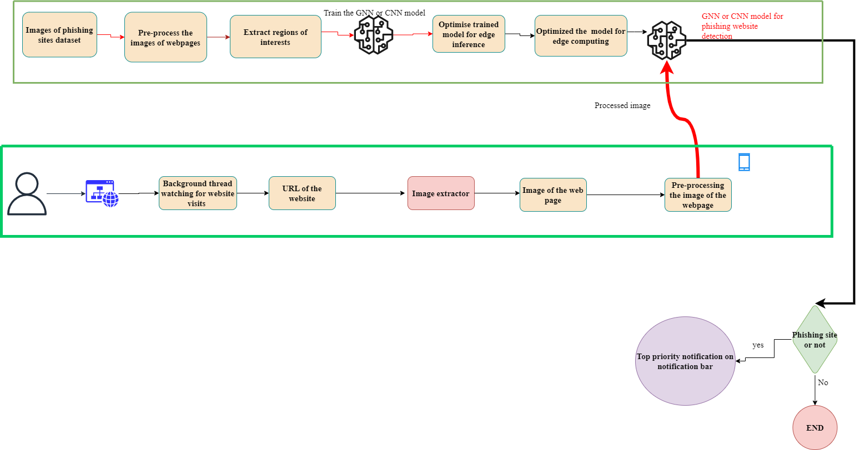
System Diagram
IT20222840 | J.M.Lindamulage| TMP-23-123

Slide 20
Methodology
Technologies
Python
Android
TensorFlow
TensorFlow lite
Algorithms
Graph Neural Network
Convolutional Neural Network
Techniques
Machine Learning and Deep learning
Image processing
Feature extraction
Web scraping
Graph Representation
Model optimization
IT20222840 | J.M.Lindamulage| TMP-23-123

Slide 21
System, Personnel and software Specification Requirements
Software Requirements
Jupiter Notebook
Android studio
Google CoLab
Non- Functional Requirements
Users must get a notification if the user accidently navigates into a phishing website.
User privacy must be preserved
There should be a high accuracy in the results.
The application should be reliable.
Functional Requirements
All models should be deployed in the device itself
App must be running in the background
Resulting models should be able to detect phishing websites
IT20222840 | J.M.Lindamulage| TMP-23-123

Slide 22
Work Breakdown Chart
Initiation
Conduct background Study
Identify the existing issues
Planning
Identify the scope
Recognize research gap
Develop research objectives
Develop methodology
Analyse feasibility of the solution
Compile project proposal
Getting approval
Design
Implementation
Evaluation
Documentation
Study Keras and TensorFlow
Recognize potential methods for the solution to be implemented
Study basics of Andorid app development
Identify the deep learning and machine learning methods which has to be tried
Find out potential datasets which can be employed for the solution
Compare and contrast potential visual features
decide evaluation criteria to measure the performance of the models
identity the best solutions in the literature which needs to be compared our solution against
Try different features with the potential methods
Compare performance and decide best features
Train models which was recognized before
Find the best performing models
Try optimization methods: model pruning and quantization
Compare against state-of-the-art methods
Compare model optimization performance against other optimization methods
Implemented the front end of the mobile app
Integrate the ML models to the app
Design wireframes for the mobile app
Create use case diagrams and scenarios
Test mobile app against use cases
Finalize the mobile app
Write the research paper
Final presentation
Release the mobile app
IT20222840 | J.M.Lindamulage| TMP-23-123

Slide 23
REFERENCES
[1] | Aya Hashim∗Razan Medani, Dr.Tahani Abdalla Attia, "Defences Against web Application Attacks and Detecting Phishing Links Using Machine Learning," in 2020 International Conference on Computer, Control, Electrical, and Electronics Engineering (ICCCEEE), Sudan, 2020.
[2] | "PHISHING ACTIVITY TRENDS REPORT 3rd Quarter," APWG, 2022.
[3] | Dr. Moulana Mohammed,K. Koteswara Prasanth,S. Venkata Sai Subhash , "PHISHING DETECTION USING MACHINE LEARNING ALGORITHMS," in Proceedings of the Fourth International Conference on Smart Systems and Inventive Technology (ICSSIT-2022), India, 2022.
[4] | A. Lakshmanarao , P.Surya Prabhakara Rao,M M Bala Krishna, "Phishing website detection using novel machine learning fusion approach," in Proceedings of the International Conference on Artificial Intelligence and Smart Systems (ICAIS-2021), India, 2021.
[5] | Surbhi Gupta,Abhishek Singhal ,Akanksha Kapoor, "A Literature Survey on Social Engineering Attacks:Phishing Attack," in International Conference on Computing, Communication and Automation, India, 2016.
[6] | Ankit Kumar Jain and B. B. Gupta, "Phishing Detection: Analysis of Visual Similarity Based Approaches," WILEY, p. 2017, 2017.
[7] | R. Dhamija, J. D. Tygar, and M. A. Hearst, "Why phishing works," in SIGCHI Conference on Human, 2006.
[8] | Z. Fan, "Detecting and Classifying Phishing Websites by Machine Learning," in 2021 3rd International Conference on Applied Machine Learning (ICAML), china, 2021.
[9] | Malak Aljabri ,Samiha Mirza , "Phishing Attacks Detection using Machine Learning and Deep Learning Models," in 2022 7th International Conference on Data Science and Machine Learning Applications (CDMA) , Saudi Arabia, 2022.
[10] | "Phishing Website Detection Using Random Forest and Support Vector Machine: A Comparison," in 2nd International Conference on Artificial Intelligence and Data Sciences (AiDAS), Malaysia, 2021.
[11] | Jaydeep Solanki, Rupesh G. Vaishnav, "Website Phishing Detection using Heuristic Based Approach," International Research Journal of Engineering and Technology (IRJET), vol. 03, no. 05, 2016.
[12] | Eric Medvet,Engin Kirda,Christopher Kruegel, "Visual-Similarity-Based Phishing Detection," in SecureComm 2008 , Turkey, 2008.
[13] | Igino Corona1,2, Battista Biggio1,2, Matteo Contini2Luca Piras1,2, Roberto Corda2Mauro, Guido Mureddu2, "DeltaPhish: Detecting Phishing Webpages in Compromised Websites∗," in ESORICS 2017., Italy, 2017.
[14] | Sahar Abdelnabi,Katharina Krombholz,Mario Fritz, "VisualPhishNet: Zero-Day Phishing Website Detection by Visual Similarity," 2020.
[15] | U. Saeed, "Visual similarity-based phishing detection using deep learning," Journal of Electronic Imaging, vol. 31, no. 5, 2022.
[16] | Padmalochan Panda 1,†, Alekha Kumar Mishra 1,† and Deepak Puthal , "A Novel Logo Identification Technique for Logo-Based Phishing Detection in Cyber-Physical Systems," Future Internet, vol. 14, no. 8, 2022.
[17] | Saad Al-Ahmadi1 Yasser Alharbi, "DEEP LEARNING TECHNIQUE FOR WEB PHISHING DETECTION COMBINED URL FEATURES AND VISUAL SIMILARITY," International jpurnal of computer networks abd comunications(IJCNC), vol. 12, no. 5, 2020.
[18] | Rundong Yang,Kangfeng Zheng, Bin Wu,Chunhua Wu,Xiujuan Wang, "Phishing Website Detection Based on Deep Convolutional Neural Network and Random Forest Ensemble Learning," sensors, 2021.
[19] | "Phishing Detection: Analysis of Visual Similarity Based Approaches," WILEY, vol. 2017, 2017.
IT20222840 | J.M.Lindamulage| TMP-23-123

Slide 24
IT19966236 | Mandira Pabasari L.
BSc (Hons) Degree in Information Technology (specialization in Cyber Security )
IT19966236 | Mandira Pabasari L.| TMP-23-123

Slide 25
Introduction
Background
Phishing involves social engineering and technological fraud to steal user information.
Scammers trick victims into thinking they are dealing with a legitimate site.
Devices are used to intercept usernames and passwords or misdirect users to fake websites.
This results in the theft of financial and personal information. [1][2]
IT19966236 | Mandira Pabasari L.| TMP-23-123

Slide 26

Research Gap
IT19966236 | Mandira Pabasari L.| TMP-23-123

Slide 27
Features/Models | [7] | [6] | [8] | [5] | [3] | Proposed Model
Uses network traffic analysis | ✔️ | ✔️ | ❌ | ❌ | ✔️ | ✔️
Uses machine learning | ✔️ | ✔️ | ✔️ | ✔️ | ✔️ | ✔️
Provides real-time blocking | ❌ | ❌ | ❌ | ❌ | ❌ | ✔️
Works on desktop and mobile | ❌ | ❌ | ❌ | ❌ | ❌ | ✔️
IT19966236 | Mandira Pabasari L.| TMP-23-123

Slide 28
Research Problem
Develop a phishing detection system that utilizes network traffic analysis.
Enhance the accuracy and reliability while minimizing false positives and false negatives.
Should be capable of detecting new and unknown phishing attacks and be able to adapt to evolving techniques used by attackers.
To enable real-time detection and prevention of phishing attacks.
IT19966236 | Mandira Pabasari L.| TMP-23-123

Slide 29


Objectives
Specific objective
Detect phishing websites using network traffic features.
IT19966236 | Mandira Pabasari L.| TMP-23-123

Slide 30
Sub Objectives
Collect and preprocess network traffic data to use for training and testing the model.
Develop a machine learning model that can accurately classify network traffic as either legitimate or phishing.
Optimize the model to improve its accuracy and reduce its inference time.
Implement the model in a real-time system to provide instant phishing detection and prevention.
IT19966236 | Mandira Pabasari L.| TMP-23-123

Slide 31
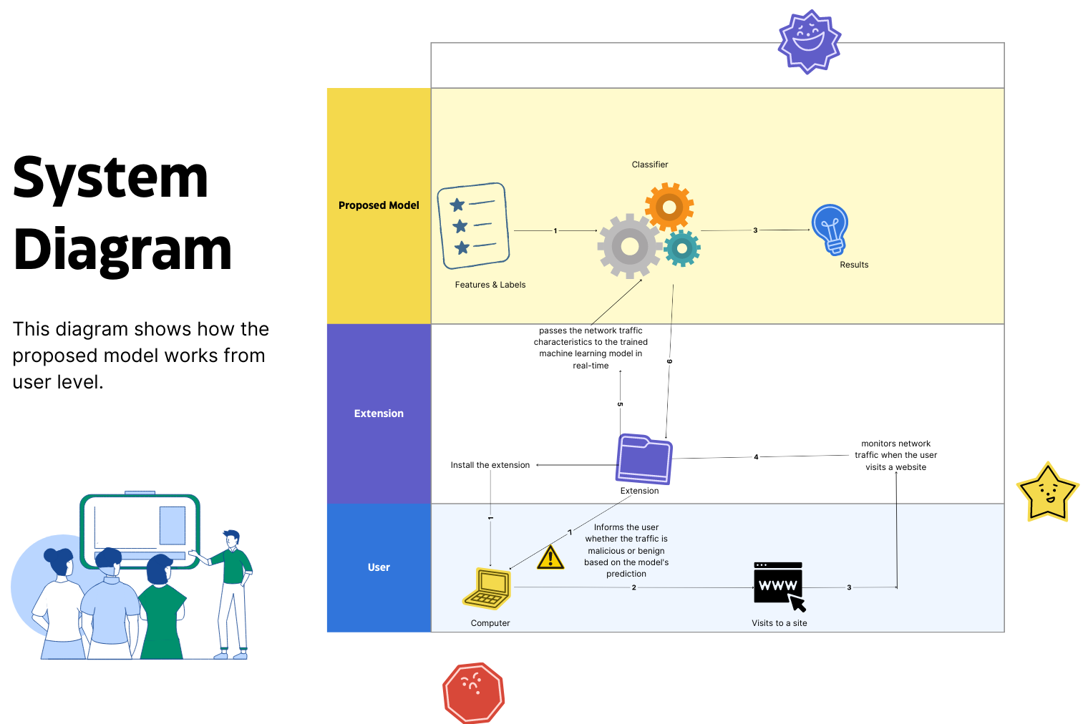
IT19966236 | Mandira Pabasari L.| TMP-23-123

Slide 32
Methodology
Technologies
Python
JavaScript
Algorithms
Random Forest
Decision Tree
K-Nearest Neighbors
Techniques
Machine Learning
Data Preprocessing
Feature Extraction
Model Training and Evaluation
IT19966236 | Mandira Pabasari L.| TMP-23-123

Slide 33
System, Personnel and software Specification Requirements
Software Requirements
Jupiter Notebook
JavaScript
Non- Functional Requirements
The system should be scalable and able to handle a large amount of network traffic.
The system must have a fast response time, with results delivered within a few seconds of analyzing the network traffic.
Functional Requirements
The system should be able to analyze network traffic in real-time and identify potential phishing attacks.
The system should be able to generate alerts or block access to suspicious websites in real-time.
IT19966236 | Mandira Pabasari L.| TMP-23-123

Slide 34
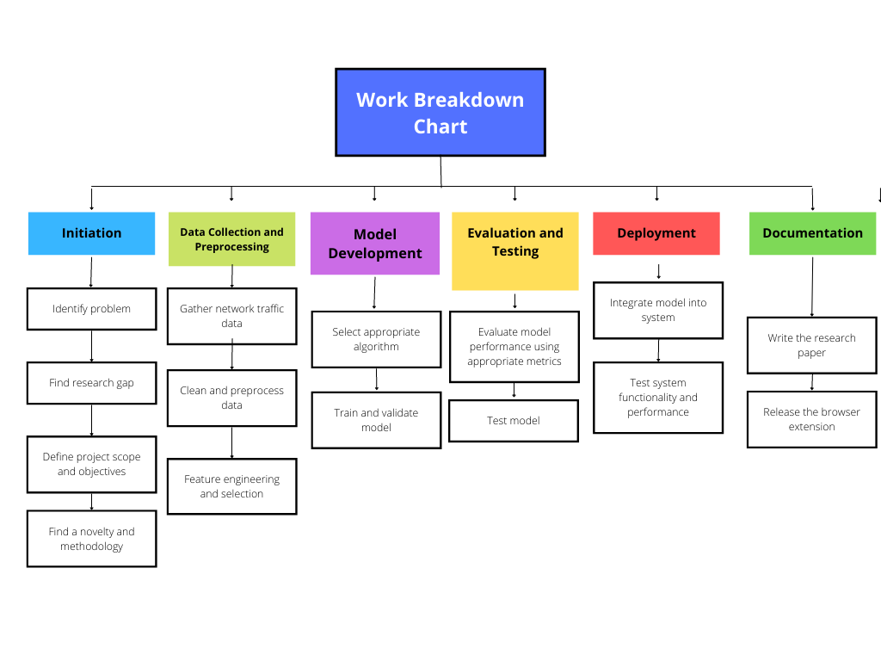
IT19966236 | Mandira Pabasari L.| TMP-23-123

Slide 35
References
[1] "PHISHING ACTIVITY TRENDS REPORT," APWG, 2022.
[2] "PHISHING ACTIVITY TRENDS REPORT 3rd Quarter 2022," APWG.
[3] Samaneh Mahdavifar, Nasim Maleki, Arash Habibi Lashkari, Matt Broda, Amir H. Razavi, "Classifying Malicious Domains using DNS Traffic Analysis," 2021.
[4] Wesam Fadheel , Steve Carr, Wassnaa Al-Mawee, "On Phishing: Proposing a Traffic Behavior-Based Model to Detect, Prevent, and Classify Webpage Suspicious and Malicious Activities".
[5] Ankit Kumar Jain, B. B. Gupta, "Comparative Analysis of Features Based Machine Learning Approaches for Phishing Detection".
[6] Wesam Fadheel, Wassnaa Al-Mawee, Steve Carr, "On Phishing: URL Lexical and Network Traffic Features Analysis and Knowledge Extraction using Machine Learning Algorithms (A Comparison Study)".
[7] Syifa Maliah Rachmawati, Dong-Seong Kim, and Jae-Min Lee, "Machine Learning Algorithm in Network Traffic Classification".
[8] Kai Lei†,‡, Qiuai Fu†,‡, Jiake Ni†, Feiyang Wang†, Min Yang¶, Kuai Xu§, "Detecting Malicious Domains with Behavioral Modeling and Graph Embedding".
IT19966236 | Mandira Pabasari L.| TMP-23-123

Slide 36

IT20050108 | S. P. J. Yapa
BSc (Hons) Degree in Information Technology (specialization in Cyber Security)
IT20050108 | S. P. J. Yapa | TMP-23-123

Slide 37

Component 3 - Phishing email detection with sentiment analysis
IT20050108 | S. P. J. Yapa | TMP-23-123

Slide 38
Background
A phishing email is a type of email that is designed to trick the recipient into providing sensitive information [1].
Phishing Email Detection Tool…….
Sentiment analysis…….
IT20050108 | S. P. J. Yapa | TMP-23-123

Slide 39

Research Gap
IT20050108 | S. P. J. Yapa | TMP-23-123

Slide 40
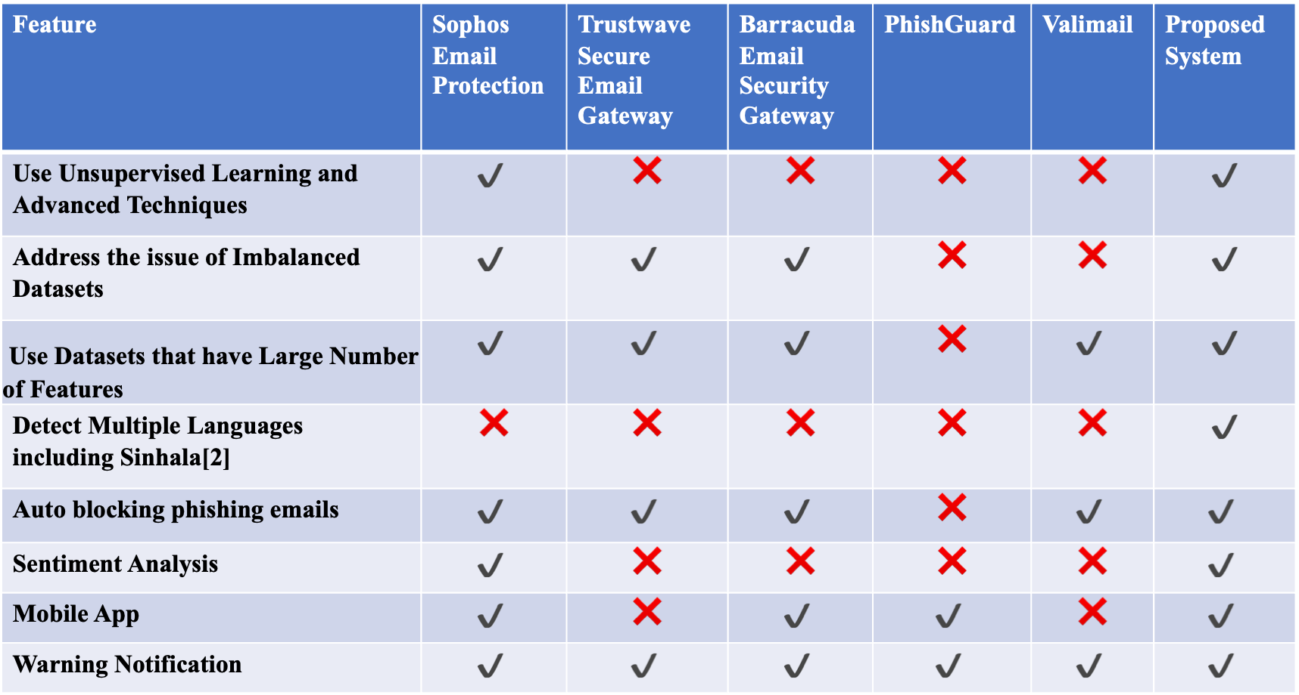
Feature | Sophos Email Protection | Trustwave Secure Email Gateway | Barracuda Email Security Gateway | PhishGuard | Valimail | Proposed System
Use Unsupervised Learning and Advanced Techniques | $$✔️$$ | ❌ | ❌ | ❌ | ❌ | $$✔️$$
Address the issue of Imbalanced Datasets | $$✔️$$ | $$✔️$$ | $$✔️$$ | ❌ | ❌ | $$✔️$$
Use Datasets that have Large Number of Features | $$✔️$$ | $$✔️$$ | $$✔️$$ | ❌ | $$✔️$$ | $$✔️$$
Detect Multiple Languages including Sinhala[2] | ❌ | ❌ | ❌ | ❌ | ❌ | $$✔️$$
Auto blocking phishing emails | $$✔️$$ | $$✔️$$ | $$✔️$$ | ❌ | $$✔️$$ | $$✔️$$
Sentiment Analysis | $$✔️$$ | ❌ | ❌ | ❌ | ❌ | $$✔️$$
Mobile App | $$✔️$$ | ❌ | $$✔️$$ | $$✔️$$ | ❌ | $$✔️$$
Warning Notification | $$✔️$$ | $$✔️$$ | $$✔️$$ | $$✔️$$ | $$✔️$$ | $$✔️$$
IT20050108 | S. P. J. Yapa | TMP-23-123

Slide 41

RESEARCH PROBLEM
How to use unsupervised learning or other advanced techniques for detecting phishing emails.
How to address the issue of imbalanced datasets, which can affect the accuracy of the model[3].
How to use datasets that have large number of features[4].
Detect phishing emails that in multiple languages include Sinhala.
How to use sentiment analysis for detect phishing emails.
How to make the email blocker to auto block the phishing email sender[5].
IT20050108 | S. P. J. Yapa | TMP-23-123

Slide 42

Objectives
Specific Objective
Phishing email detection with sentiment analysis
IT20050108 | S. P. J. Yapa | TMP-23-123

Slide 43

Sub Objectives
To develop a machine learning model that can detect phishing emails using sentiment analysis.
To make an email blocker to auto block the phishing email sender.
To improve the model to detect multiple languages including Sinhala.
To integrate the developed models to a mobile application.
IT20050108 | S. P. J. Yapa | TMP-23-123

Slide 44
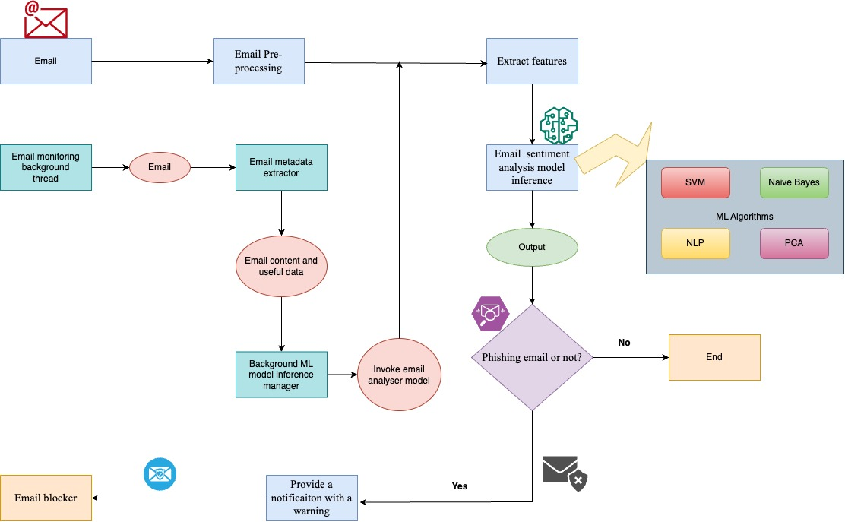
SYSTEM DIAGRAM
IT20050108 | S. P. J. Yapa | TMP-23-123

Slide 45


METHODOLOGY
Technologies
Python
Android
TensorFlow
TensorFlow lite
Algorithms
Support Vector Machine (SVM)
Naive Bayes
Natural Language Processing (NLP)
Principal Component Analysis (PCA)
Techniques
Machine Learning and Deep learning
Feature Extraction
Sentiment Analysis
Model Training
IT20050108 | S. P. J. Yapa | TMP-23-123

Slide 46

REQUIREMENTS
Software Requirements
Jupiter Notebook
Android studio
Google CoLab
Non- Functional Requirements
Users must get a notification if the user received a phishing email.
User privacy must be preserved.
There should be a high accuracy in the results.
The application should be reliable.
Functional Requirements
All models should be deployed in the device itself
App must be running in the background
Resulting models should be able to detect phishing emails
IT20050108 | S. P. J. Yapa | TMP-23-123

Slide 47
Work Breakdown Chart
Initiation
Planning
Design
Implementation
Evaluation
Documentation
Conduct background Study
Identify the scope
Compare and contrast existing tools
Try different features with the potential methods
Compare against state-of-the-art methods
Write the research paper
Identify the existing issues
Study Keras and TensorFlow
Identify the deep learning and machine learning methods which has to be tried
Compare performance and decide best features
Compare model optimization performance against other optimization methods
Final presentation
Recognize research gap
Study basics of Andorid app development
decide evaluation criteria to measure the performance of the models
Train models which was recognized before
Test mobile app against use cases
Release the mobile app
Develop research objectives
Recognize potential methods for the solution to be implemented
identity the best solutions in the literature which needs to be compared our solution against
Find the best performing models
Finalize the mobile app
Develop methodology
Find out potential datasets which can be employed for the solution
Design wireframes for the mobile app
Try optimization methods: model pruning and quantization
Analyse feasibility of the solution
Create use case diagrams and scenarios
Implemented the front end of the mobile app
Compile project proposal
Integrate the ML models to the app
Getting approval
IT20050108 | S. P. J. Yapa | TMP-23-123

Slide 48

REFERENCES
[1] Tanusree Sharma, Priscilla Ferronato, and Masooda Bashir, Phishing Email Detection Method: Leveraging Data Across Different Organizations
[2] Duo Pan, Ellen Poplavska, Yichen Yu, Susan Strauss, Shomir Wilson, A Multilingual Comparison of Email Scams, 2020
[3] Enaitz ezpeleta, iñaki velez de mendiz abal, josé maría gómez hidalgo, urko zurutuza , Novel email spam detection method using sentiment analysis and personality recognition, 14 January 2020
[4] Tanusree Sharma and Masooda Bashir, An Analysis of Phishing Emails and How the Human Vulnerabilities are Exploited, 2020
[5] Sikha Bagui, Debarghya Nandi, Subhash Bagui and Robert Jamie White, Machine Learning and Deep Learning for Phishing Email Classification using One-Hot Encoding, 2021
[6] Ala Mughaid, Shadi AlZu’bi, Adnan Hnaif, Salah Taamneh, Asma Alnajjar, Esraa Abu Elsoud, An intelligent cyber security phishing detection system using deep learning techniques, 14 May 2022
[7] C.J. Hutto, Eric Gilbert, VADER: A Parsimonious Rule-based Model for Sentiment Analysis of Social Media Text
[8] Said salloum, tarek gaber, sunil vadera, and khaled shaalan, A systematic literature review on phishing email detection using natural language processing techniques, 2022
[9] Srishti Rawal, Bhuvan Rawal, Aakhila Shaheen, Shubham Malik, Phishing Detection in E-mails using Machine Learning, 2017
[10] Rakesh Verma and Nabil Hossain, Semantic Feature Selection for Text with Application to Phishing Email Detection
IT20050108 | S. P. J. Yapa | TMP-23-123

Slide 49

IT20222468|Perera I.S.S.
BSc (Hons) Degree in Information Technology (specialization in Cyber Security )
IT20222468 | Perera I.S.S. | TMP-23-123

Slide 50

Introduction
Background
Nowadays Phishing becomes a main area of concern for security researchers. Because it is not difficult to create the fake website which looks so close to .legitimate website. Experts can identify fake websites but not all the users can .identify the fake website and such users become the victim of phishing attack. .Main aim of the attacker is to steal banks account credentials. Phishing attacks are becoming successful because lack of user awareness. Since phishing attack exploits the weaknesses found in users, it is very difficult to mitigate them, but it is very important to enhance phishing detection techniques.
IT20222468 | Perera I.S.S. | TMP-23-123

Slide 51

Research Gap
IT20222468 | Perera I.S.S. | TMP-23-123

Slide 52
 | Machine Learning Algorithms Evaluation for Phishing URLs Classification | Phishing URL Detection based on Machine Learning Techniques and URL Features | Machine Learning for Multiple Stage Phishing URL Prediction | Phishing Detection and Prevention using Chrome Extension | Detecting email-based phishing websites using machine learning
URL blocker
extension
Give warning message to user
Uses machine learning
IT20222468 | Perera I.S.S. | TMP-23-123

Slide 53
Research Problem
Phishing website detection is an important task in cybersecurity as it helps to prevent users from falling victim to such attacks.
URL-based detection is a popular approach to phishing website detection, where various features of the URL such as domain, path, and query parameters are analyzed to determine the legitimacy of the website.
Machine learning has shown promising results in detecting phishing websites using URL features.
However, designing an efficient and accurate machine learning model that can generalize well to new and unseen phishing websites is still a challenging research problem.
IT20222468 | Perera I.S.S. | TMP-23-123

Slide 54
Objectives
Specific objective
Phishing web site detection using URL.
IT20222468 | Perera I.S.S. | TMP-23-123

Slide 55
Sub objectives
Investigate the effectiveness of different URL features for phishing website detection.
Evaluate the performance of different machine learning algorithms for phishing website detection using URL features.
Design an optimized machine learning model that can achieve high accuracy and efficiency in detecting phishing websites using URL features.
Compare the performance of the proposed model with existing state-of-the-art phishing website detection methods.
Made URL blocker to block the Pshing URLs
IT20222468 | Perera I.S.S. | TMP-23-123

Slide 56
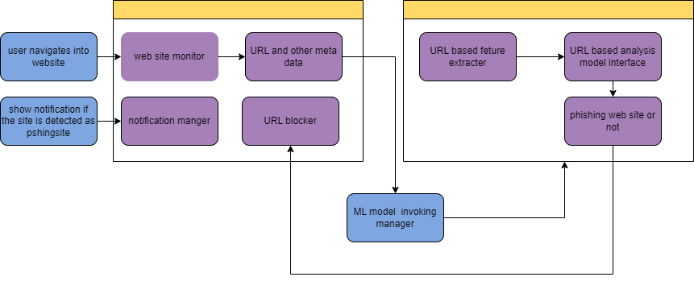
System Diagram
IT20222468 | Perera I.S.S. | TMP-23-123

Slide 57
Methodology
Data collection
Feature selection
Machine learning model selection
Model optimization
Model evaluation
Analysis and interpretation
Make the extension
Make the URL blocker
IT20222468 | Perera I.S.S. | TMP-23-123

Slide 58
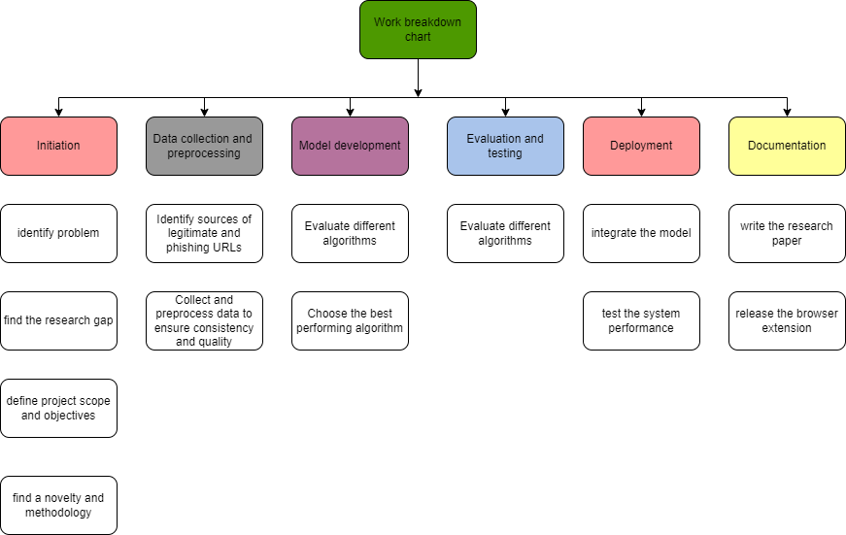
Work Breakdown Chart
IT20222468 | Perera I.S.S. | TMP-23-123

Slide 59
REFERENCES
https://www.trendmicro.com/en_hk/what-is/phishing/types-of-phishing.html. [Online].
https://www.sciencedirect.com/science/article/pii/S1319157823000034. [Online].
P. D. a. P. u. C. Extension.
U. P. D. u. M. Learning.
M. L. A. E. f. P. U. Classification.
Machine learning based phishing detection from URLs Koray Sahingoz a, Ebubekir Buber b, Onder Demir b, Banu Diri c
Phishing Website Detection using Machine Learning Algorithms Rishikesh Mahajan Irfan Siddavatam
Somaiya Vidyavihar
IT20222468 | Perera I.S.S. | TMP-23-123

Slide 60
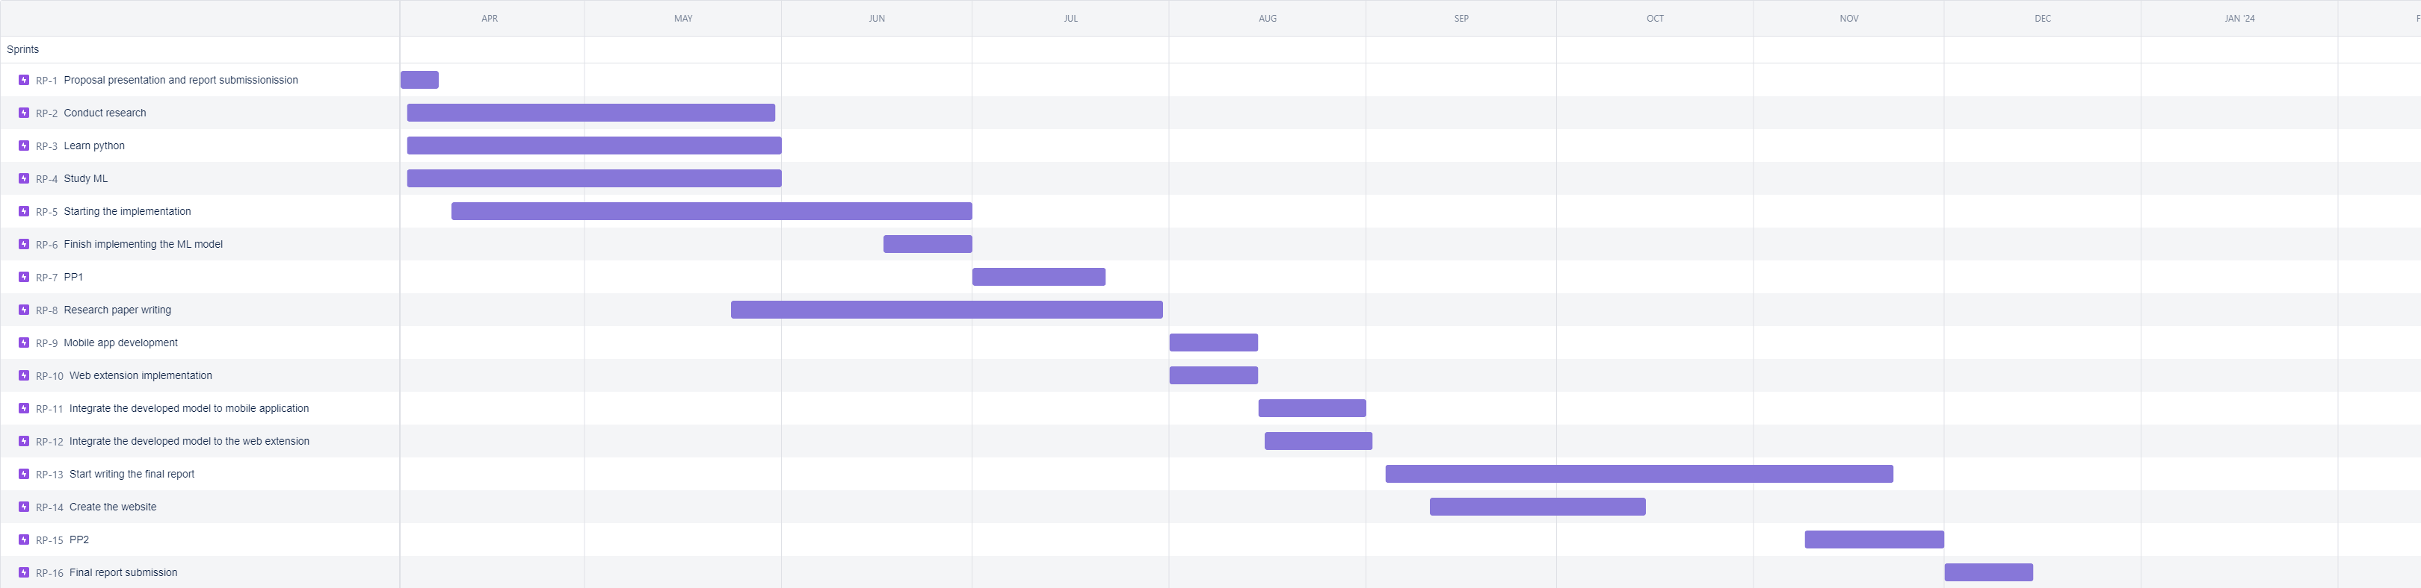
GANTT CHART

Slide 61
Commercialization
Targeted Audience
Internet users
Professionals
Email users
End user benefits
Protect from phishing emails
Protect from phishing websites
Getting a warning notification
Ability to block the URL and the email sender

Slide 62
Budget
Components
Price
Component | Price
Google CoLab | Rs.3500(9$ per month)
Firebase Database | Rs.1000
Google cloud | Rs.200
Hosting | Rs.3000
Total | Rs.7700

Slide 63


